Slide 1
DESIGN
workshop

Slide 2

Hello!
WE’RE DESIGNERS
Today we'll learn:
-Basics
-Tools
-Tutorial
-Important links

Slide 3
La conception est pensée rendue visible.
(design is thinking made visible)
-Saul Bass

Slide 4
What is Design?
What is the scope of Designing?

Slide 5

PHOTOSHOP
1
Let’s start with the basics first

Slide 6
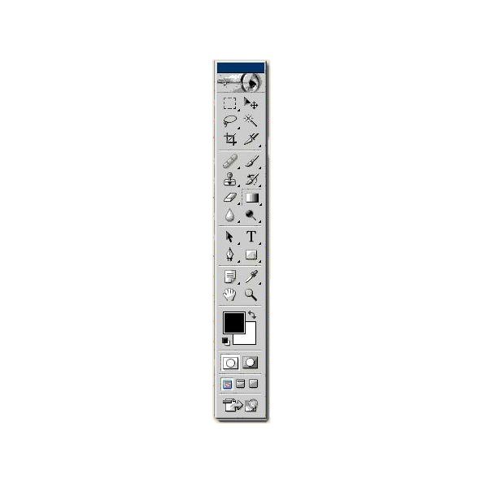
TOOLS
Move tool
Magic wand tool
Slice tool
Brush tool
History brush tool
Gradient tool
Magnifier
Type tool
Rectangle tool
Eye-dropper tool
Zoom tool
Switch color
Quick mask mode
Marquee tool
Lasso tool
Crop tool
Healing Brush tool
Clone Stamp tool
Eraser tool
Blur tool
Direct selection tool
Pen tool
Notes tool
Hand tool
Foreground color
Default color
Standard mode
Screen modes
Switch to image ready

Slide 7

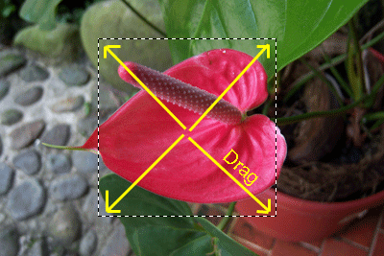
TOOLS
Rectangular Marquee Tool
Use this tool to make selections on your image, in a rectangular shape. This changes the area of your image that is affected by other tools or actions to be within the defined shape. Holding the [Shift] key while dragging your selection, restricts the shape to a perfect square. Holding the [Alt] key while dragging sets the center of the rectangle to where your cursor started.

Slide 8

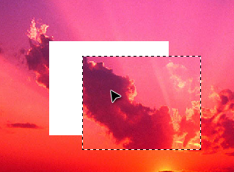
TOOLS
2. Move Tool
Use this tool to, well, move things. Usually you use it to move a Layer around after it has been placed. Hold the [Shift] key to limit the movements to vertical/horizontal.

Slide 9

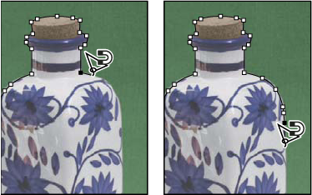
TOOLS
3. Polygon Lasso Tool
Ok, this should be the Lasso Tool, but I use the Polygon Lasso a lot more often. Use this to draw selections in whatever shape you would like. To close the selection, either click on the beginning point (you&#8217;ll see the cursor change when you&#8217;re on it), or just double-click. When holding the [Ctrl] key, you&#8217;ll see the cursor change, and the next time you click, it will close your selection.

Slide 10

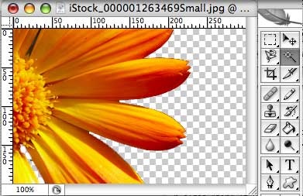
TOOLS
4. Magic Wand Tool
Use this to select a color range. It will select the block of color, or transparency, based on wherever you click. In the Options Bar at the top, you can change the Tolerance to make your selections more/less precise.

Slide 11

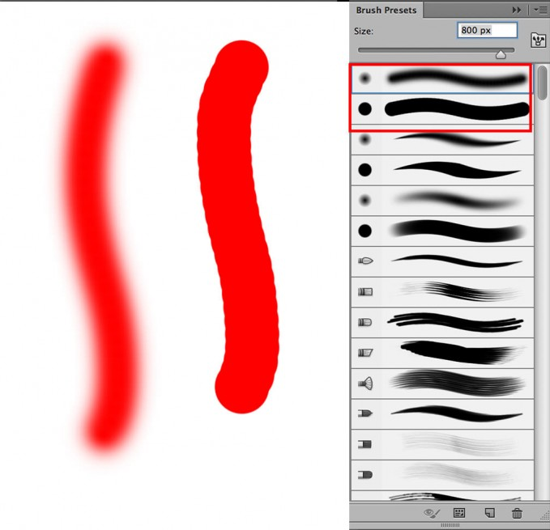
TOOLS
5. Brush Tool
This is one of the first tools ever. It is what Photoshop is based off of. Well, not really, but it is pretty basic. It paints one your image, in whatever color you have selected, and whatever size you have selected. There is a lot of options for it, but this is basic, so you don’t get to learn them.

Slide 12

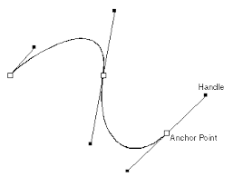
TOOLS
6. Pen Tool
I mentioned this tool above. It is for creating paths, in which you would use the Path Selection Tool to select the path. Paths can be used in a few different ways, mostly to create clipping paths, or to create selections. You use the tool by clicking to add a point. If you click and drag, it will change the shape of your path, allowing you to bend and shape the path for accurate selections and such

Slide 13

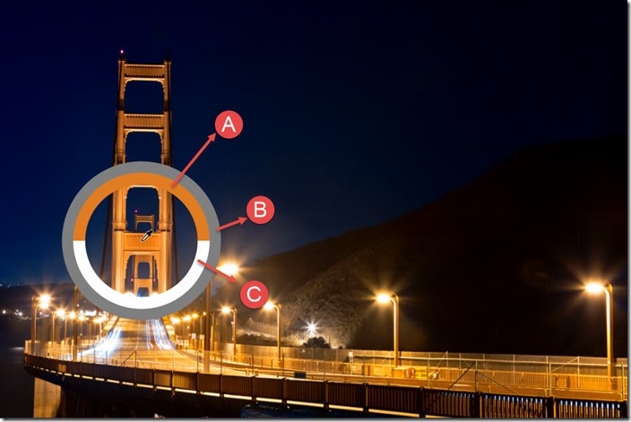
TOOLS
7. Eyedropper Tool
This tool works by changing your foreground color to whatever color you click on. Holding the [Alt] key will change your background color.

Slide 14
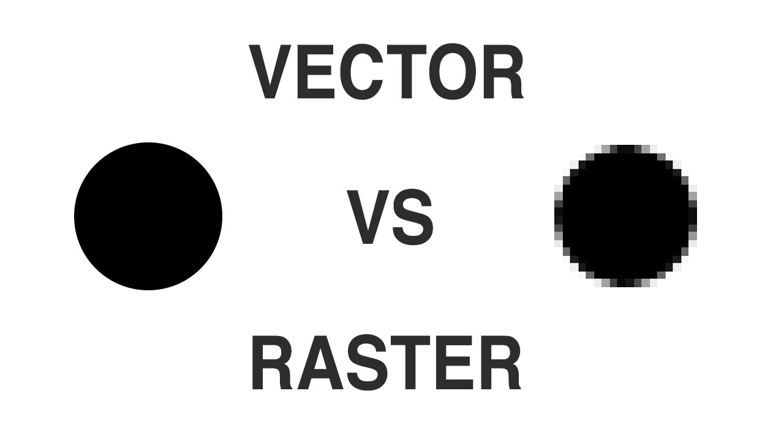
RASTER V/S VECTOR
VECTOR
composed of paths.
RASTER
composed of pixels.

Slide 15
Lets see how we use
Ps
We’re going to implement something on Ps and side by side learn how to use Ps.
What you’ve to do is make something like this:

Slide 16
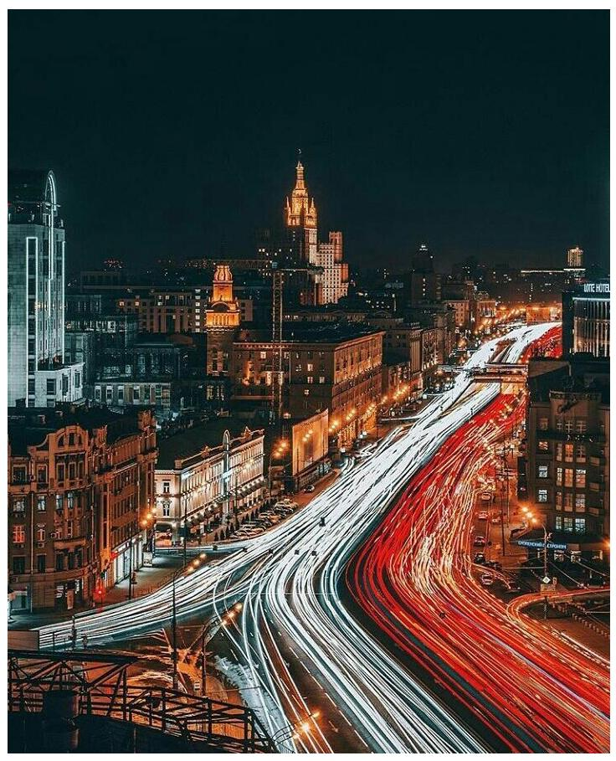
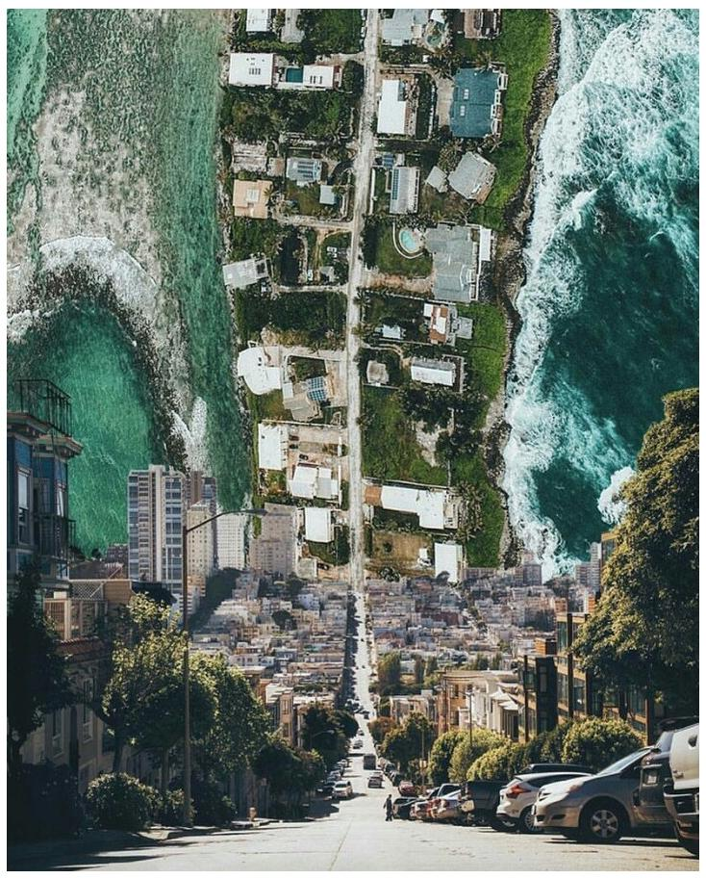
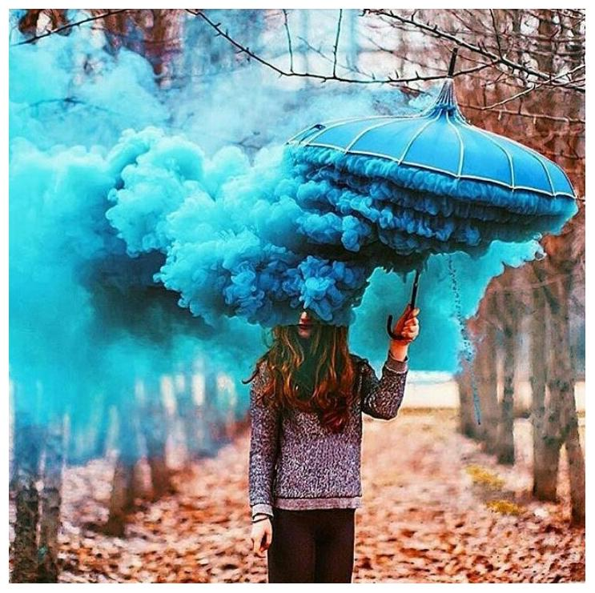
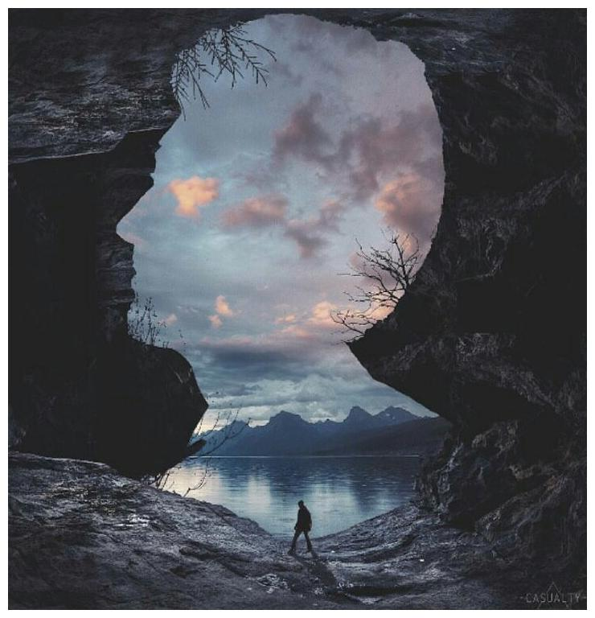
INSPIRATIONAL
MANIPULATIONS

Slide 17
TASK 1
Now at this stage of learning you can try something on your own.
So here’s a task for you:
You’ve to design a poster for “Advance Design
Workshop”.
The winning poster will be posted on the Official NCS FB page and website.

Slide 18
Thanks!
ANY QUESTIONS?
Please fill a anonymous feedback so that we can improve our shortcomings.

Slide 19
IMPORTANT LINKS
Free Resources
www.dafont.com
www.flaticon.com
www.dribbble.com
Tutorials
www.creativebloq.com
www.speckyboy.com/photoshop-tutorials
www.design.tutsplus.com
www.pegaweb.com

Slide 20
CREDITS
Special thanks to all the Alumni and our Seniors who see potential in us and given this opportunity to represent our work through NCS.

Slide 21
PRESENTATION DESIGN
Dark gray #2e3037
Aqua #39c0ba
Salmon #f35b69
Blue #6d9eeb
Font: Quicksand

